Slide 1
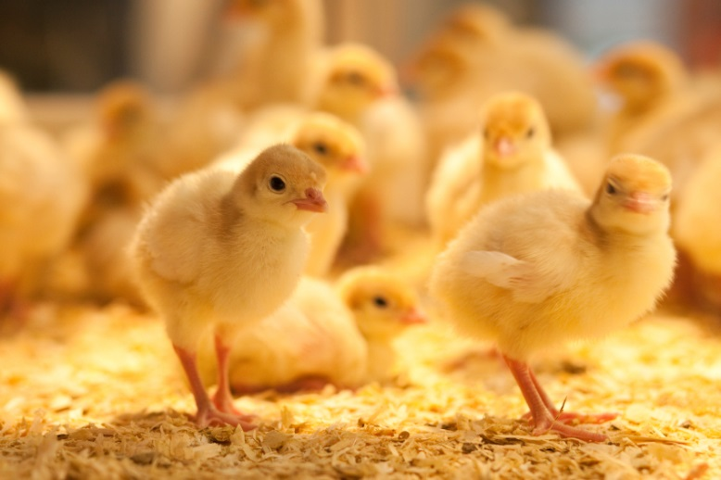
My research project G. Student, M. Professor, O. Scientist, S. Researcher
The Poultry Research Centre
Edmonton, Alberta, Canada
Summary
A poster is an excellent way to present research ideas or findings. This research was designed to address a need in the industry. Information should be clear and concise so people use the information to improve their operations.
Problem
The background provides context as to why the research is important and how it could help the poultry/processing/food/pharmaceutical industry. The hypothesis should be included in this section.
For example:
This study was designed to test if poster presentations were an effective method to deliver research findings to the industry.
Specific objectives were to:
1) Provide an opportunity for the poultry industry learn about research conducted at the Poultry Research Centre (PRC)
2) Provide an opportunity for PRC members and industry members to get to know each other
3) Highlight the talented group of graduate students so they can introduce and promote themselves to potential future employers
4) Through informal interaction and conversation, gain an understanding of the issues, challenges and opportunities that our industry is facing and how the PRC can play a role.
Figures .Include photos, and graphs that clearly demonstrate
your point. The picture or figure legend should have enough
Info that the picture or figure can be understood without the text
Our Observations
Describe in plain language what you discovered. If your research is not complete you can highlight what you know so far or use this space to talk about what you expect.
For example:
We observed that there was great interaction between students, researchers and industry members. Based on evaluations of the event, supporters of the Poultry Research Centre felt that the research was relevant and would have a positive impact in their operations. The format of poster presentations was well received.
What does this mean?
In this section the “So What” question should be answered. THIS IS THE MOST IMPORTANT SECTION. Think about the impact or your research beyond the results. What would be the impact if people were to apply this knowledge. This requires that you know about the stakeholders needs, which underlines the importance of taking advantage of this poster session to get to know industry members.
Our Approach
This is the materials and methods section. Remember that this is not a scientific presentation and therefore all the details are not necessary. For most people the type of statistical analysis conducted means nothing. If your research has not started yet you can still give some insight as to what you will be doing. Resist the temptation to abbreviate treatment names throughout the poster. If you do, the reader will have to keep referring back to this section to know what the treatments are. It makes understanding the material difficult and many readers will not bother.
Do not use technical jargon. Be brief. Pictures say a thousand words. Use them where possible to make a clear point.
Acknowledgements
Be sure to acknowledge supporters of your research. You may want to use logos instead of a written list.
Contact Information
If you are looking for a job in the near future I would suggest that you put your contact info here. However, if you are just getting started you may want to put your supervisors contact information. It should include at minimum your name, phone number and email address.
Valerie Carney
Phone: (780)415-2269
E-mail: Valerie.Carney@gov.ab.ca
Solutions for today. Foundation for the future.
Notes:
Title font should be no smaller than 85 point. Authors should be no smaller than 54 point. Sub headings should be no smaller than 48 point. Body text should be no smaller than 44 point. Captions to figures should be no smaller than 40 point.

